Slide 1
0x303 – Symmetric Encryption
ECED4406 – Computer Security
Dr. Colin O’Flynn
Dalhousie University.

Slide 2
Symmetry?

Slide 3
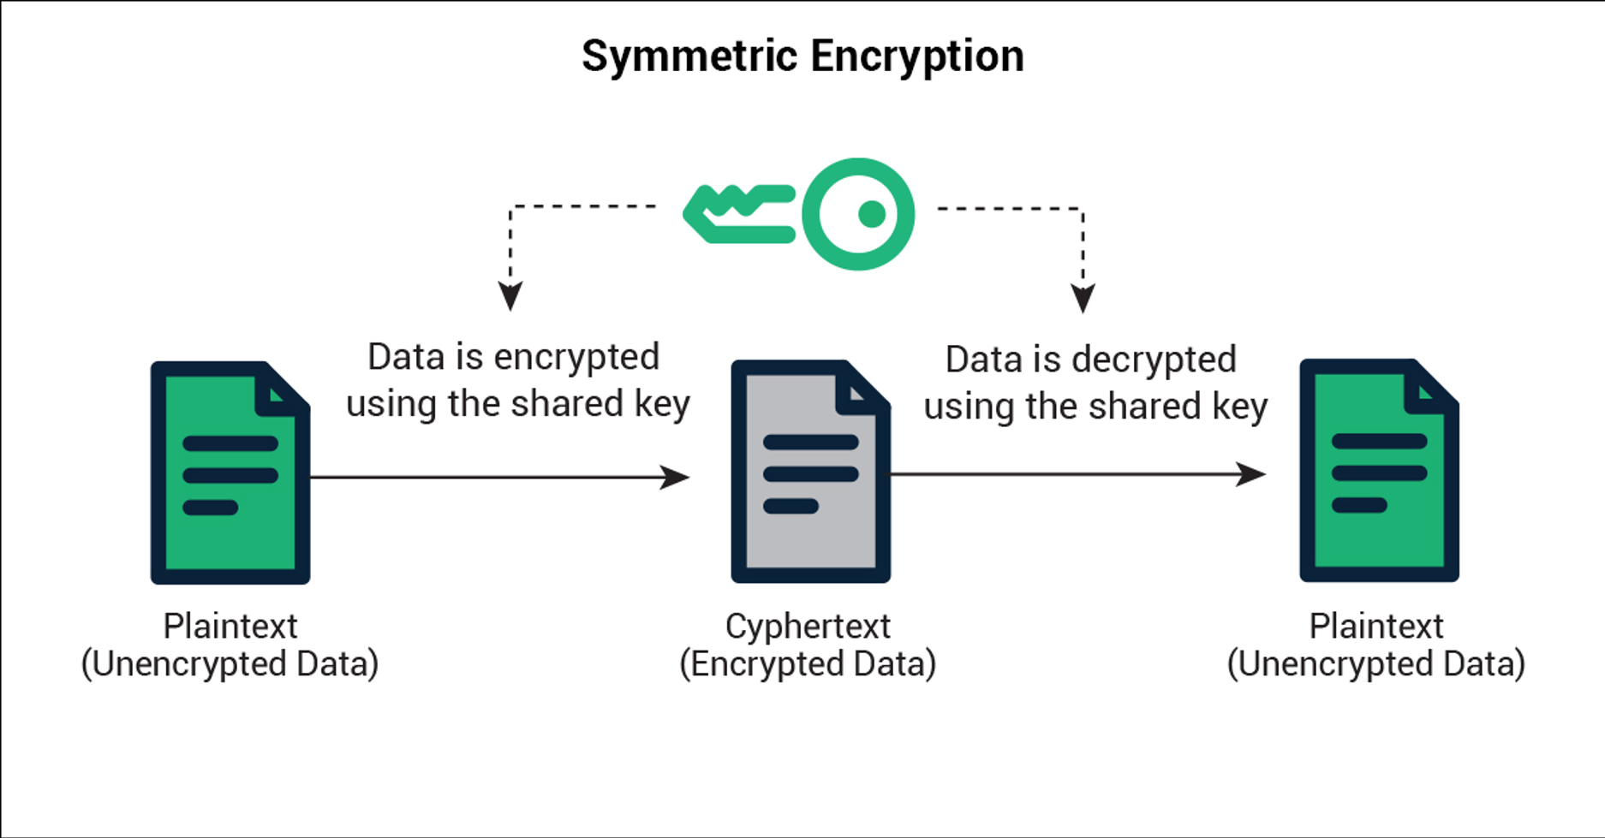
Symmetric Encryption
Symmetric encryption means the same key can perform both encryption & decryption.
Normally the algorithm for encryption & decryption are “mirrors”, but this isn’t a requirement.

Slide 4
Downsides of Symmetric Encryption?
Both sides know the secret key – impossible to determine which side encrypted a message.
Need a secure channel to transmit the secret key between sides to start with.

Slide 5
Advantages of Symmetric Encryption
Generally, the design of symmetric encryption algorithms allows them to be:
Very fast
Think encrypting/decrypting your disk drive, encryption/decryption data on a network, etc.
Fairly “small” in terms of code or hardware area.

Slide 6
Block Ciphers
Many symmetric encryption ciphers are block ciphers.
This always works on a fixed sized block (say, 16 bytes).
Encrypting more than the block size requires multiple runs.
Encryption less than the block size requires padding the input to be the full block size (the algorithms cannot work on smaller inputs).
INPUT DATA
PAD
DATA
DATA
DATA
DATA
DATA

Slide 7
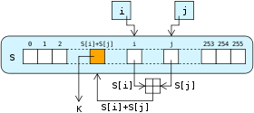
Steam Cipher
Stream ciphers work by encrypting a “byte at a time”, as the data comes.
Almost all stream ciphers work by generating a “key stream”, which is XOR’d with the plaintext to generate the ciphertext.

Slide 8
Specifications of Symmetric Algorithms
Algorithm Dependent:
Block Size → i.e., 128-bit (16 byte).
Key Size -> i.e., 128-bit (16 bytes), 256-bit (32 bytes).
Implementation Dependent:
Bytes encrypted per clock cycle, or Mbytes/second
i.e., an algorithm encrypts one block (16 bytes) in 300 clock cycles of the microcontroller.
16/300 = 0.05333 bytes/cycle
If device runs at 200 MHz:
0.05333 * 200E6 = 10.67 Mbytes/second

Slide 9
Symmetric Algorithms
Algorithm is symmetric if the same key is used for encryption & decryption.
Examples of symmetric algorithms:
AES
DES
3DES
RC4

Slide 10
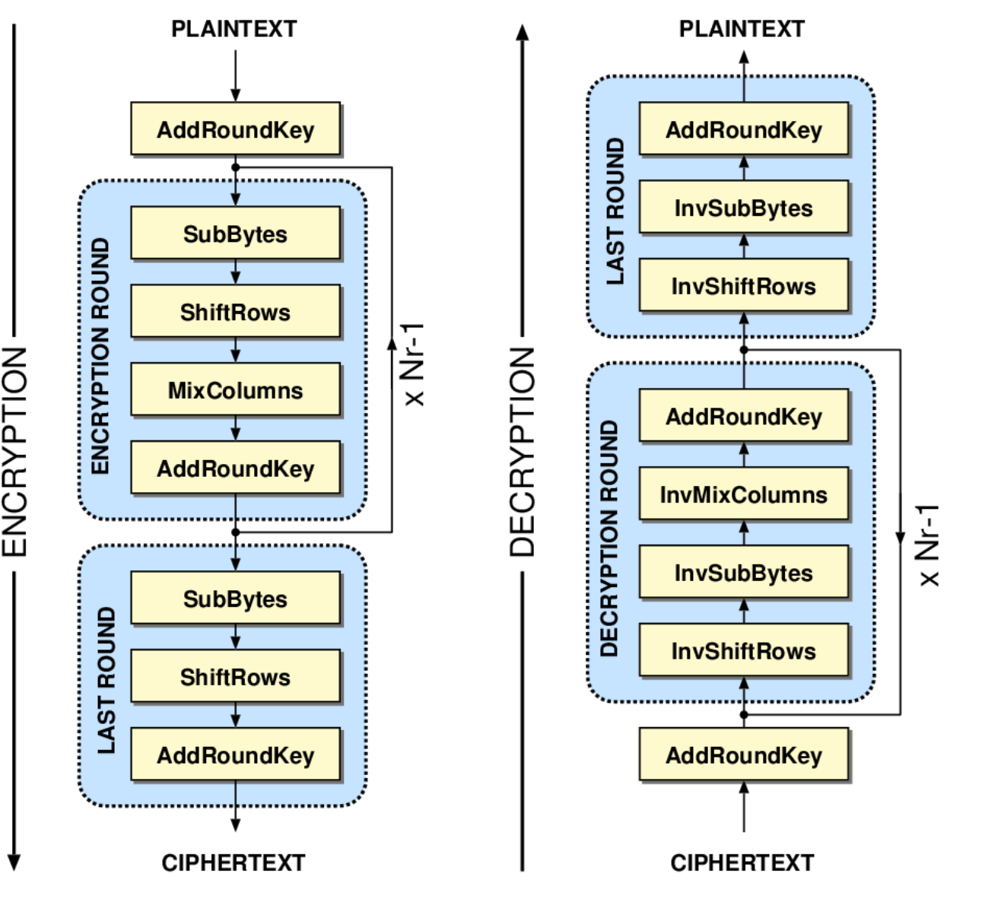
Advanced Encryption Standard (AES)
AES takes 16 bytes of input.
AES generates 16 bytes of output.
The block size of AES is always 16 bytes.
AES can have one of 3 “key sizes”:
AES-128: 16 bytes
AES-192: 24 bytes
AES-256: 32 bytes
Each iteration through the loop is called a round.
A round performs the same operations.

Slide 11
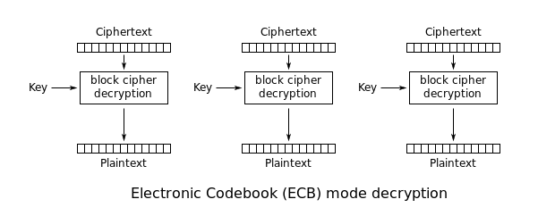

Slide 12


Applying AES-ECB to a Message
AES-ECB

Slide 13
What happened??
The same data always encrypts to the same data.
Overall structure (in this case an image) remains.
ECB alone provides little security – if someone figures out what one block means once, it’s game over!

Slide 14

Accomplishing an expected image encryption.
AES-???

Slide 15
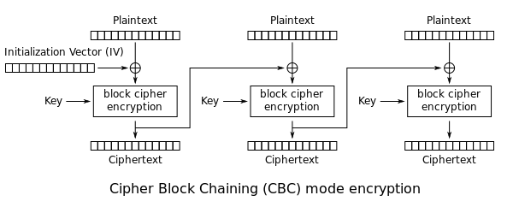
Cipher Block Chaining (CBC)

Slide 16
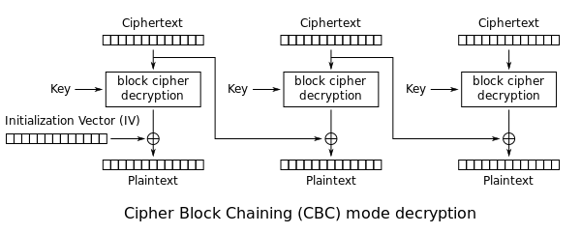
AES-CBC Mode Usage
In AES-CBC, a random Initialization Vector (IV) is used, which is normally not a secret. The IV must be given to the decryption algorithm.
AES-CBC depends on previous ciphertext (cannot decrypt arbitrary blocks without previous block access).
AES-CBC in decryption is vulnerable to bit flipping attack:

Slide 17
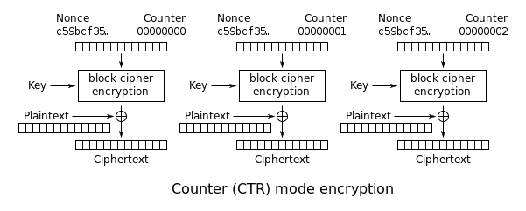
Counter Mode

Slide 18
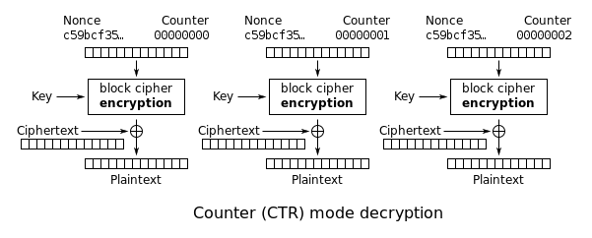
Counter Decryption – Same Thing

Slide 19
Counter Mode I.V.?
Note the addition of a Nonce – Number Used Once
What happens if Nonce is re-used?

Slide 20
Counter Mode as Stream Cipher
You can notice that the counter mode effectively generates a keystream based on our encryption key, the nonce, and the counter.
If the nonce is reused to encryption different data, the keystream will be the same.
If an attacker has known ciphertext & plaintext they could recover the keystream, and thus use the known keystream to attack a situation where they have unknown plaintext.

Slide 21
Nonce Reuse Warning (Cont’d)
Simple example:
Imagine you use AES-CTR mode in a communications interface.
Every message re-uses the nonce, such the same keystream is generated.
Attacker forces a “known” message (such as sending a query to the device).
Attacker records the “ciphertext”.
Attacker performs “message XOR ciphertext” to recover keystream.
Attacker then records unknown messages, and decrypts it with known keystream.

Slide 22
AES-CTR Mode Usage
AES-CTR mode relies on a simple structure.
Provided nonce reuse can be enforced it is a good choice.
AES-CTR mode can decrypt arbitrary blocks, as just need to provide the counter input.

Slide 23
AES Mode Summary
Several AES modes that you can use.
AES-ECB should not be used to encrypt large blocks of data!
Suitable mode depends on your usage requirements.

